Slide 1

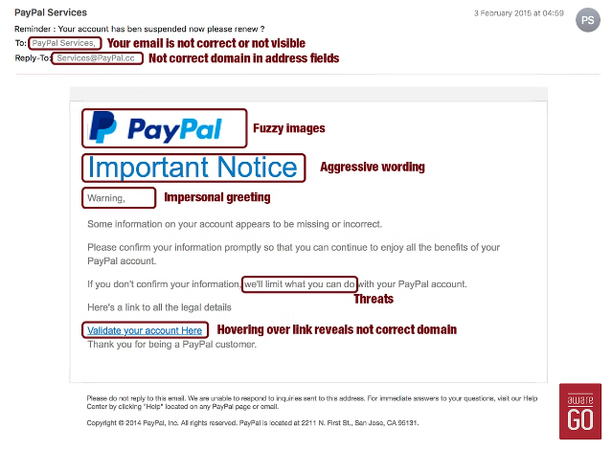
Phishing Site and Email Spam Detection
Cybercriminals are increasingly using phishing and email/SMS spam to steal sensitive information and cause financial harm. This report explores techniques to detect and mitigate these growing threats, protecting individuals and organizations.
-by Shambhavee Shukla

Slide 2




Cyber Threats
Phishing
Email/SMS Spam
Deceptive tactics to trick users into revealing sensitive data.
Unsolicited messages containing ads, malware, or phishing links.

Slide 3

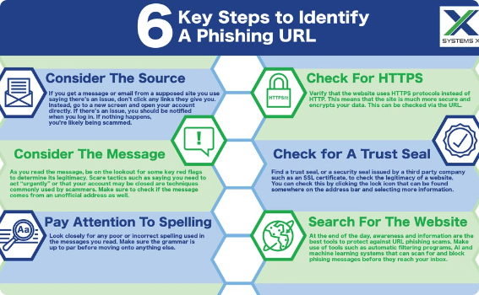
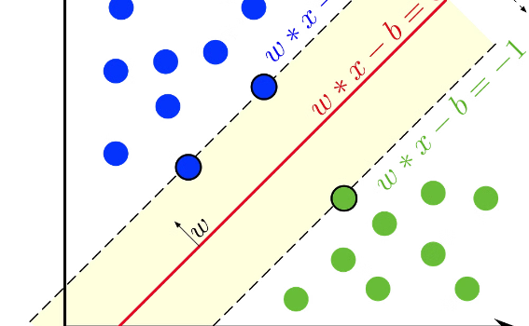
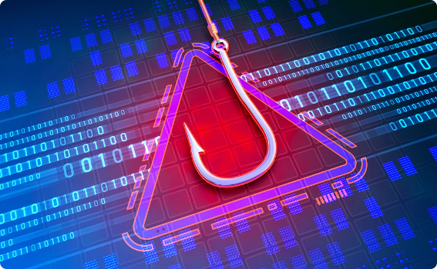
Phishing Site Detection
1)Feature Extraction
Analyze URL characteristics to detect phishing.
2)Machine Learning Model
Use SVM to classify URLs as phishing or legitimate.
3)Real-time Processing
Provide timely alerts and recommendations to users.

Slide 4

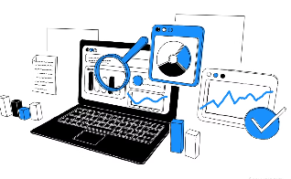

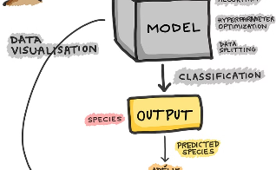
Email/SMS Spam Classifier
Data Cleaning
EDA
Data Preprocessing
Model Building
This process involves identifying and correcting errors or inconsistencies in the data to improve its quality
Helps in understanding the distribution, patterns, and anomalies in the data.
Cleaning, tokenization, and feature engineering to prepare the data.
Applying advanced algorithms like SVM, Decision Tree, and Random Forest.

Slide 5



Results and Discussion
Effective Detection
Timely Alerts
Reduced Risks
Our advanced algorithms accurately identify phishing and spam threats, helping to prevent data breaches and financial losses.
Our real-time warning system provides users with immediate notifications, allowing them to take prompt action to mitigate risks.
By effectively detecting and blocking malicious content, we help minimize the potential for data breaches and financial damages.

Slide 6
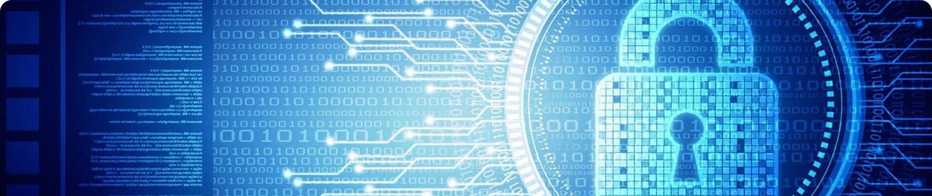
Conclusion
The phishing and email spam detection system presented in this report offers a robust solution to combat growing cyber threats. By leveraging advanced machine learning and real-time feature extraction, it enhances user security and reduces the risks of data breaches and financial losses.

